Slide 1
Physionet 2019
Early Prediction of Sepsis from Clinical Data

Slide 2

Sepsis: A life-threatening complication of an infection
Over-reaction of the immune system in response to the an infection

Slide 3

Training Data:
Collected from two separate Hospitals
5000 subjects
279 subjects with Sepsis
Data types and structures:
Clinical data: vital and lab values
Demographics details: Age, gender
Others : length of stay in the ICU/MICU

Slide 4
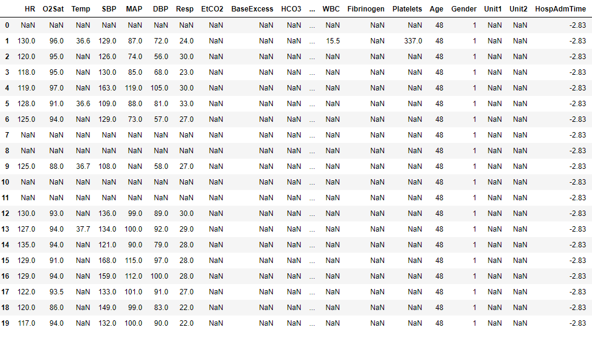
Data sample : 41 columns

Slide 5

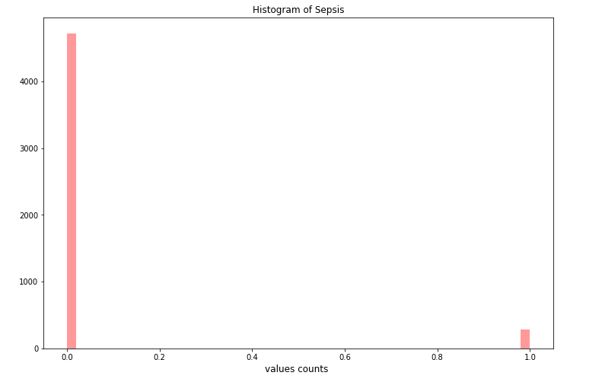
Sepsis subjects ratio
(0): subject with no Sepsis
(1): subject with Sepsis
Unbalanced Data. Only 5.5% of samples are Sepsis subjects !

Slide 6
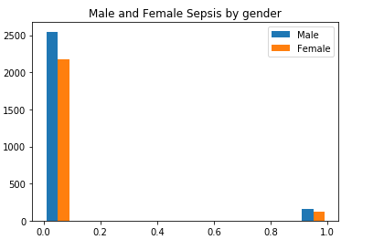


Sepsis subjects ratio
Sepsis==1
Sepsis==0

Slide 7
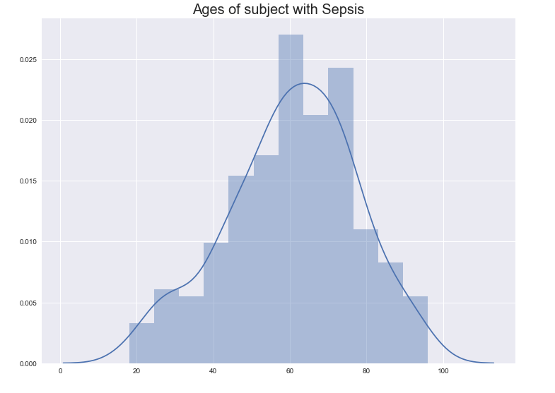
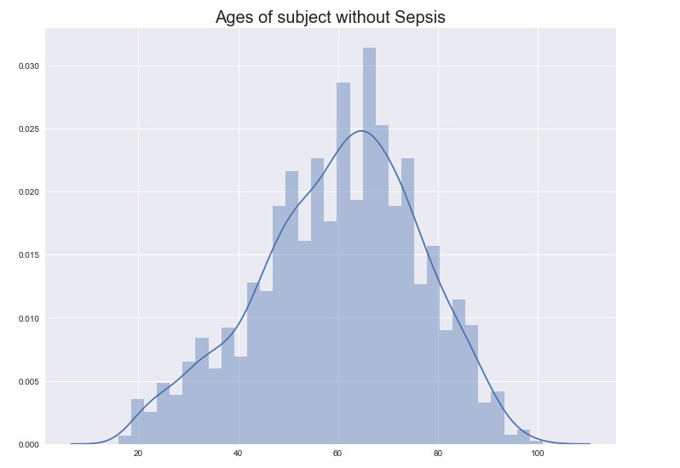
Sepsis by Age

Slide 8
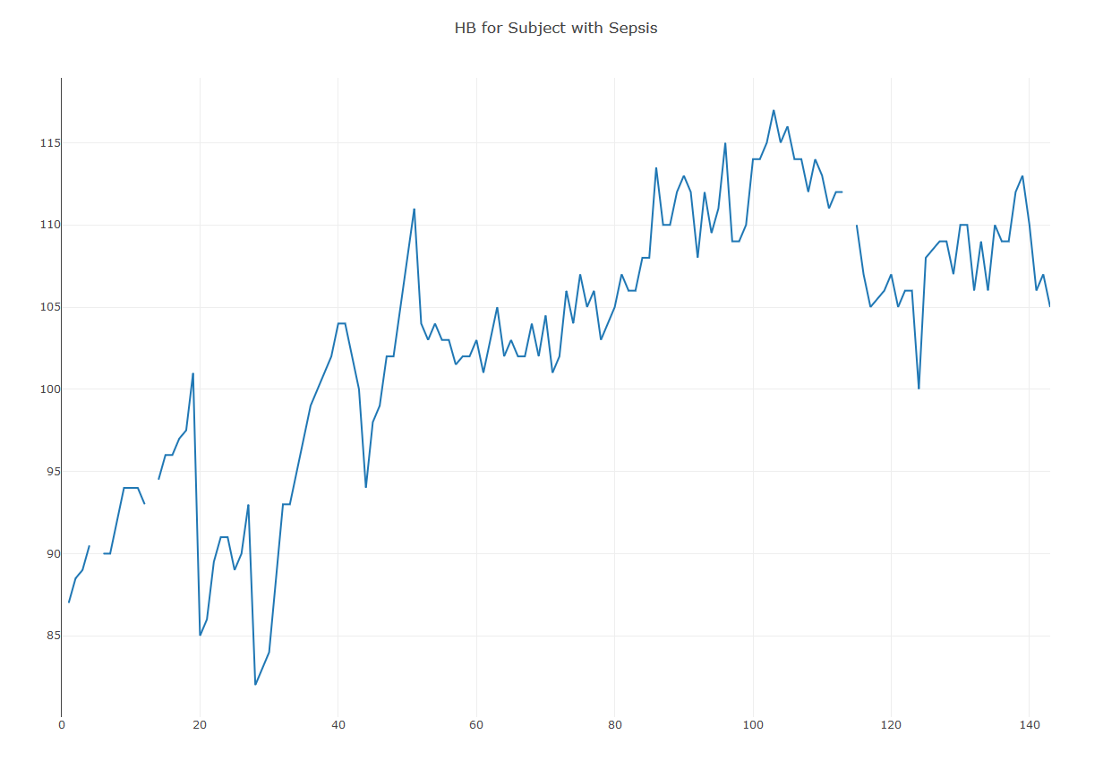
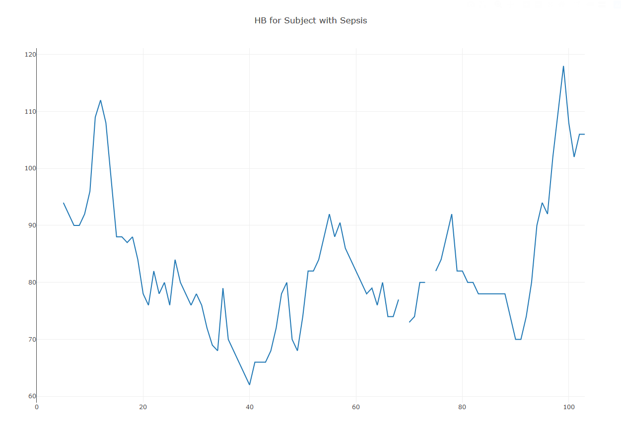
Vital signs : Heart Beat
subjects with Sepsis

Slide 9
Vital signs : Heart Beat
subjects with Sepsis

Slide 10
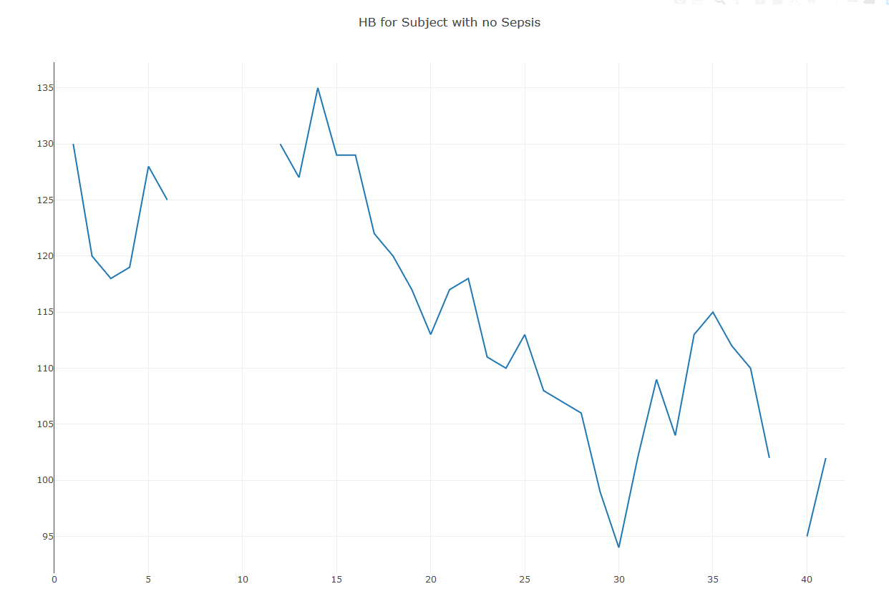
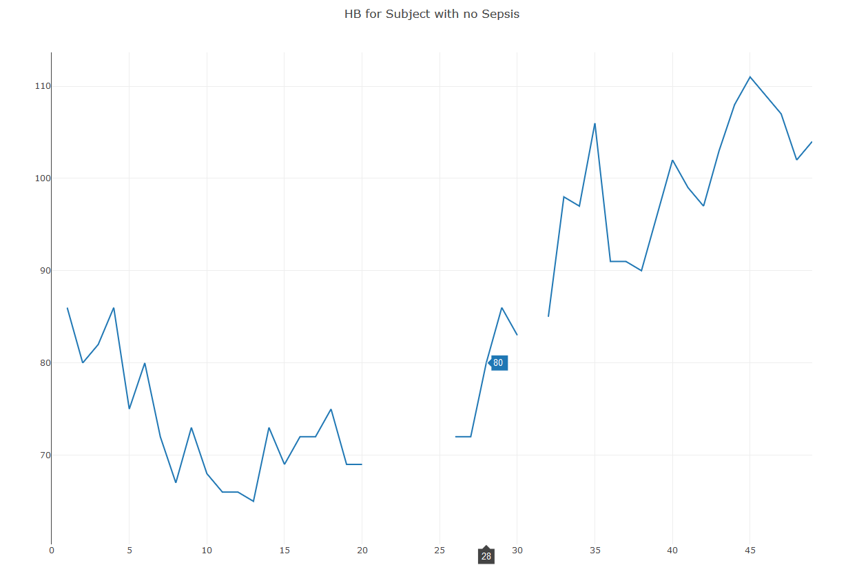
Vital signs : Heart Beat
subjects with No Sepsis

Slide 11
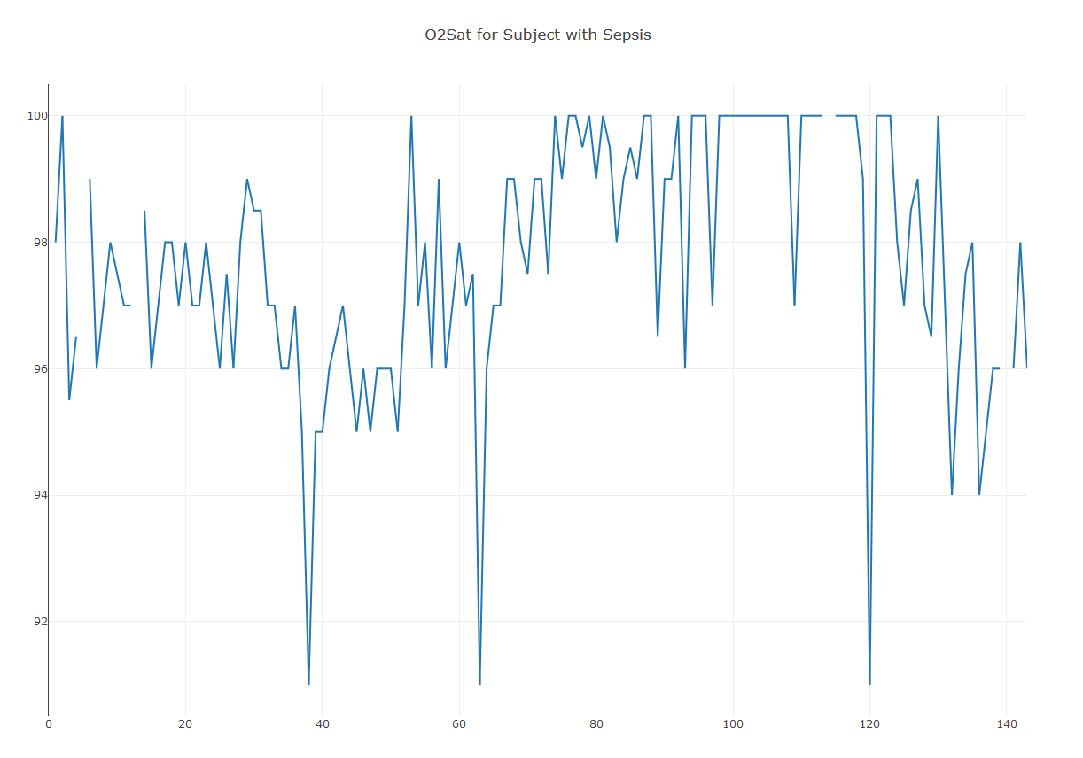
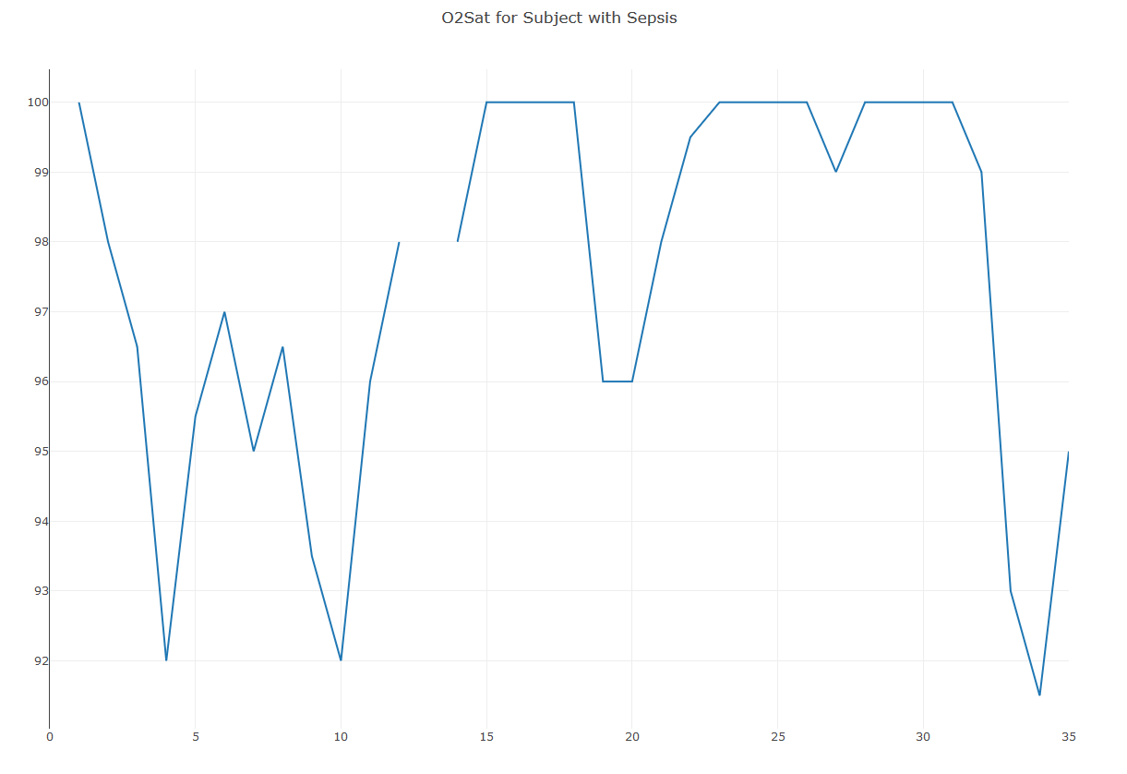
Vital signs : O2 Saturation
subjects with Sepsis

Slide 12
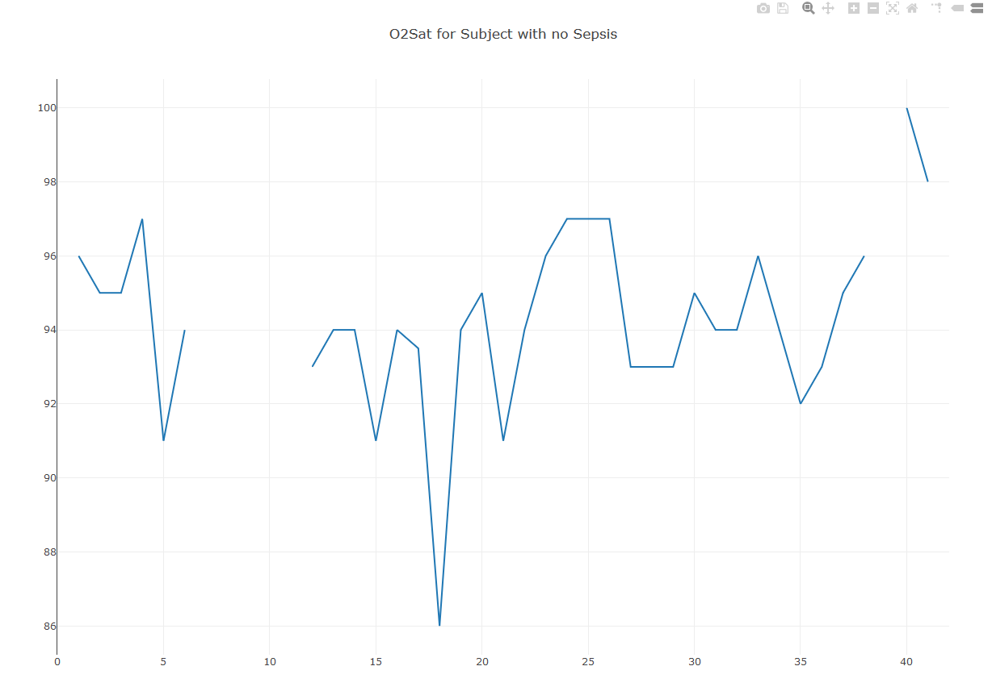
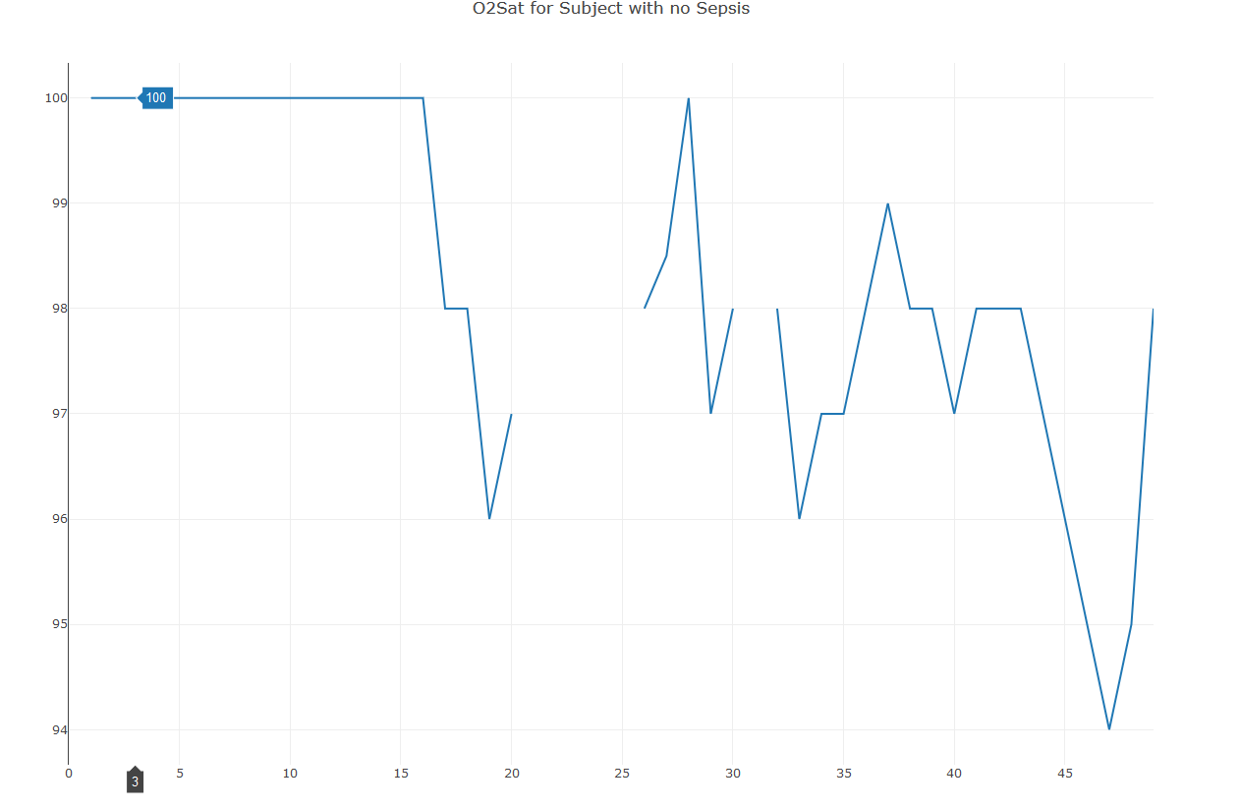
Vital signs : O2 Saturation
subjects with No Sepsis

Slide 13
Laboratory values
25 values.
Example :
Base-Excess, HCO3, FiO2
pH, PaCO2, SaO2,
Glucose, Magnesium, Phosphate, Potassium
Many missing values

Slide 14
What are we predicting
The objective is to early predict subjects with sepsis as early as possible.
Each hour (timestep) we add update of the values in the table for the subjects.
There is a moment defined as t_{Sepsis} when the subject is directly detected with sepsis by the doctors. (without help of any model)
We want a model that can predict this earlier than t_{Sepsis}
False or late predictions should be penalized (The scoring function is given, no need to write)

